Slide 1
Data Structures Workshop
Day 6

Slide 2
Workshop Outline
Linked List Deletion
Recursive Linked List Functions

Slide 3


What’s The Difference?
A.
Vs.
B.
Which one traverses through the entire linked list?
Answer: B
In what scenarios do we want to use A? Which ones for B?

Slide 4
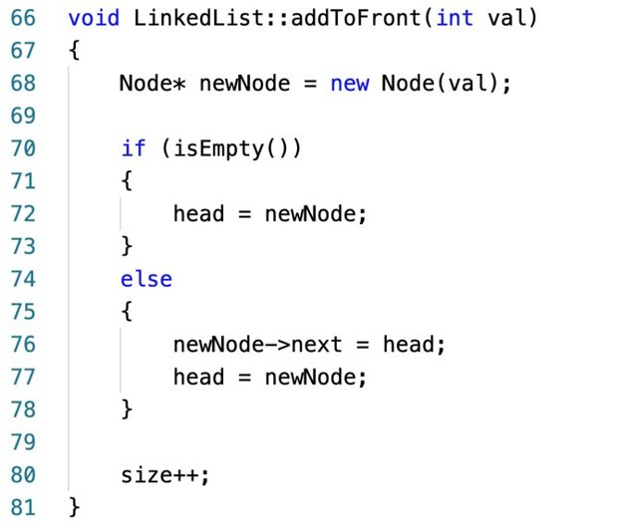
Linked List Insertion Recap
Inserting into Beginning of Linked List:

Slide 5
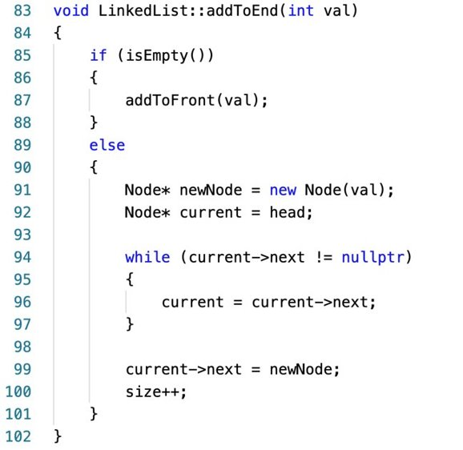
.
Inserting into End of Linked List:

Slide 6
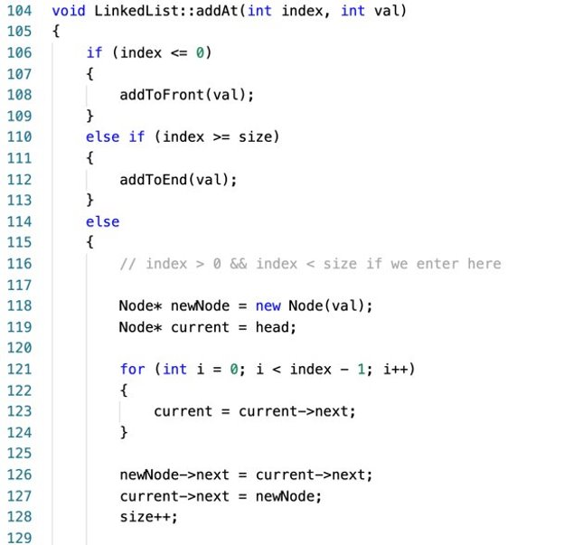
.
Inserting into Middle of Linked List (Based on Position):

Slide 7
Deleting From a Linked List

Slide 8
3 Deletion Cases
Deletion at beginning
Deletion at end
Deletion in middle (based on value OR position)
Practice: Implement these yourself on either a piece of paper or your local IDE
*** Assume you have access to a isEmpty() function and a constructor to set data to node already

Slide 9
Deletion at Beginning
Check if NOT isEmpty()
Set a temp value at the head of the linked list
Make the node after the head node your new head
Deallocate temp from memory (“old head”)

Slide 10
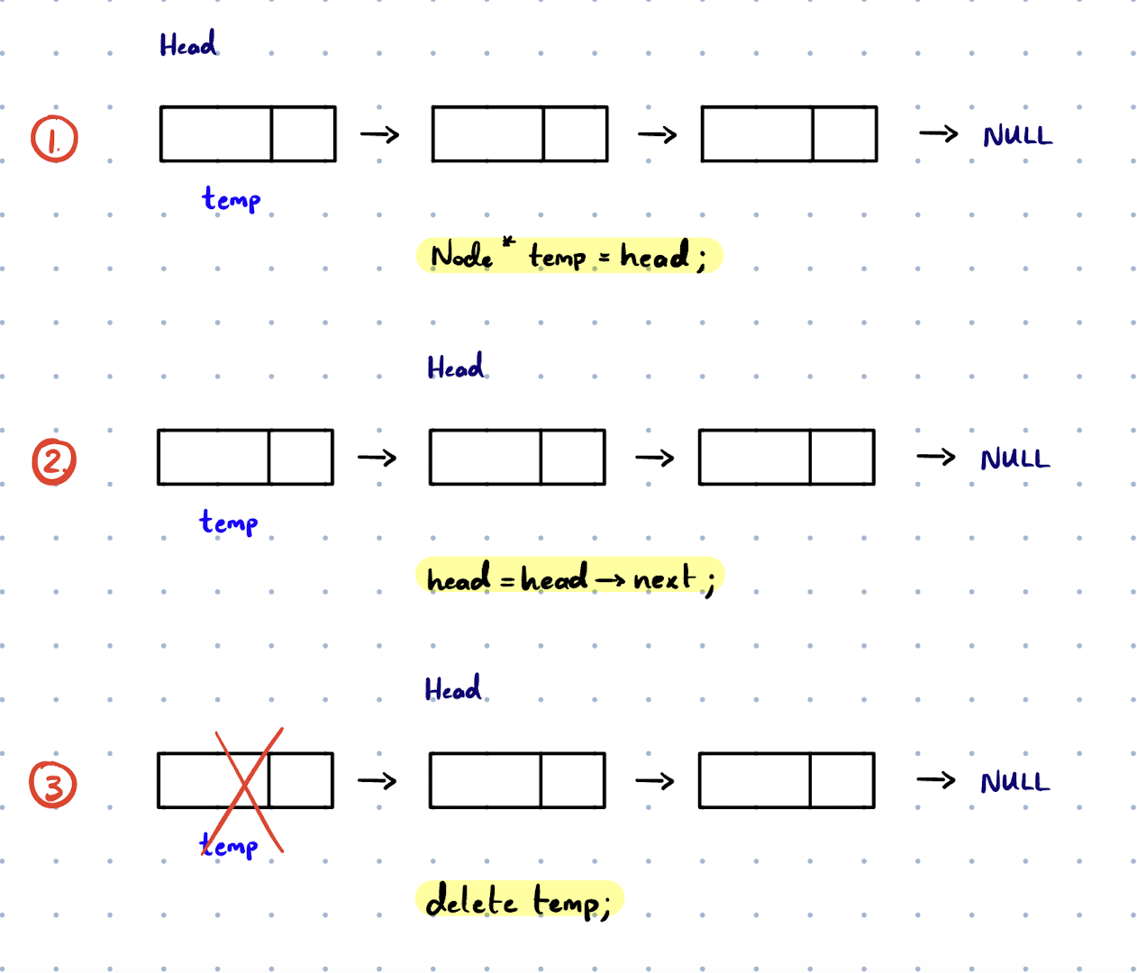
Illustration showing the process

Slide 11
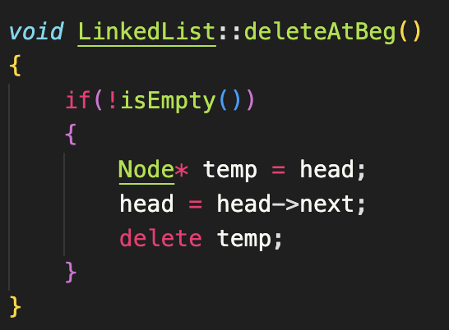
Solution

Slide 12
Deletion at End
Check if NOT isEmpty()
Check if there’s only 1 element in Linked List
If so, delete head, then set to nullptr
If there are multiple elements in the Linked List, traverse to the second to last element
Set a temp value to the last node, set to NULL, then deallocate it’s memory

Slide 13
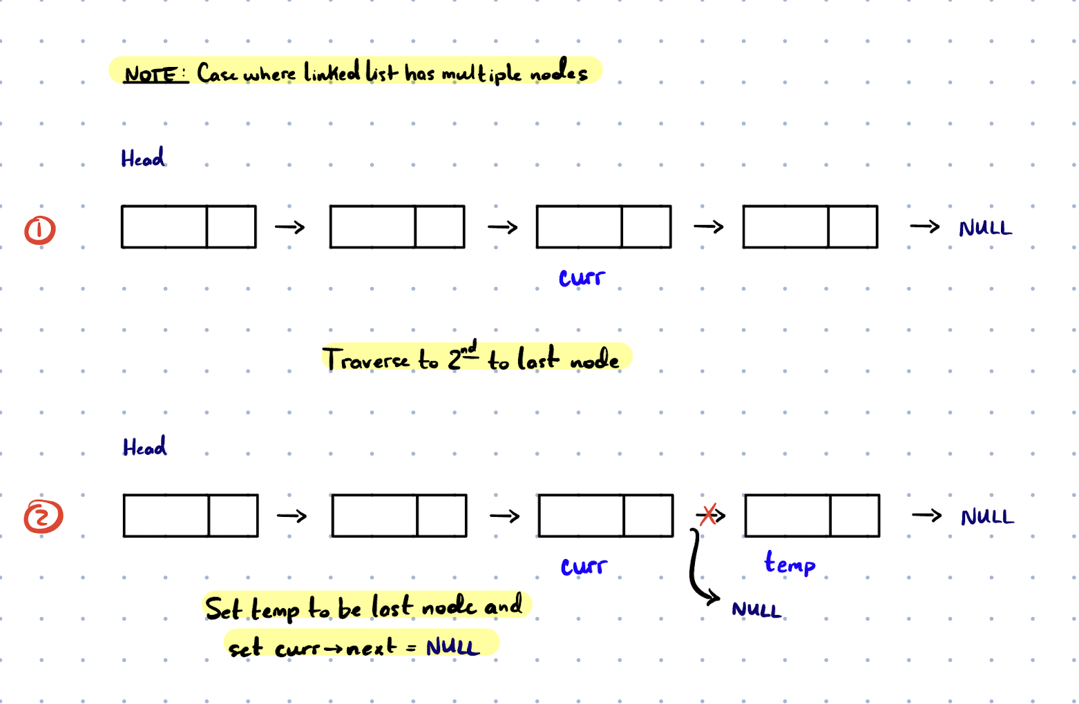
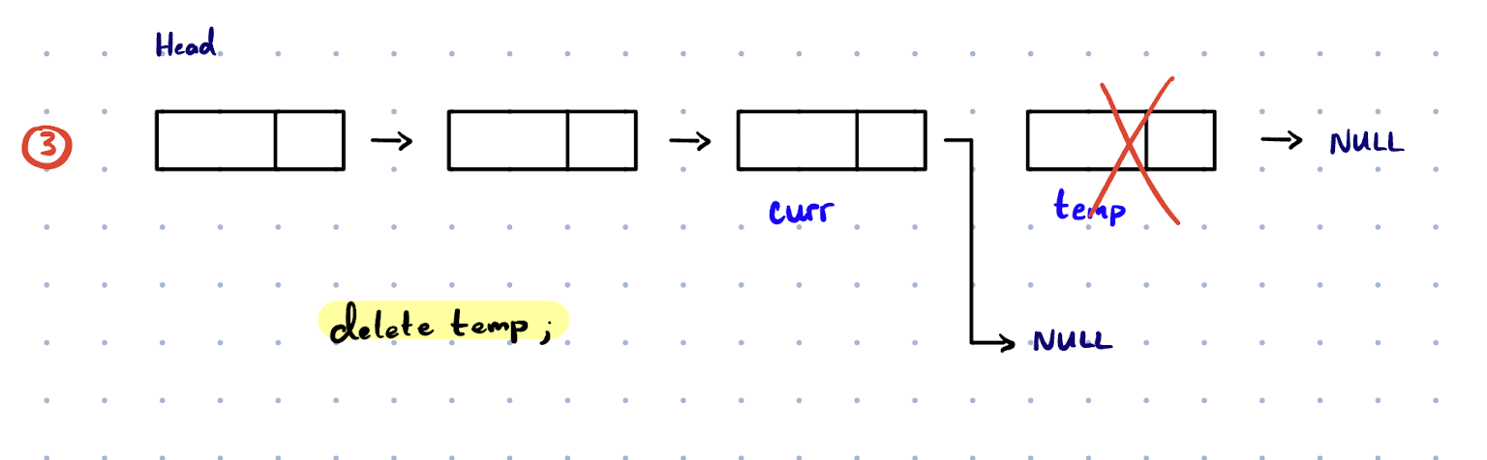
Illustration

Slide 14
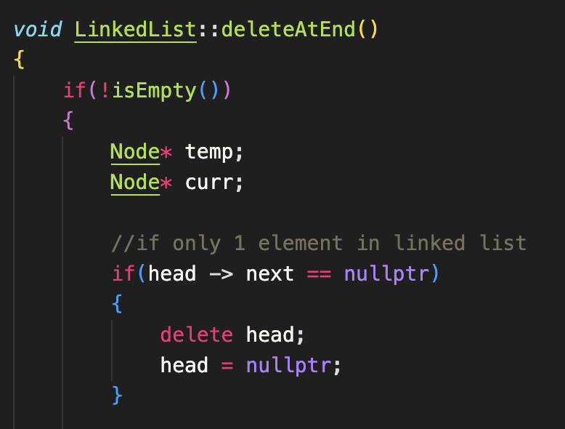
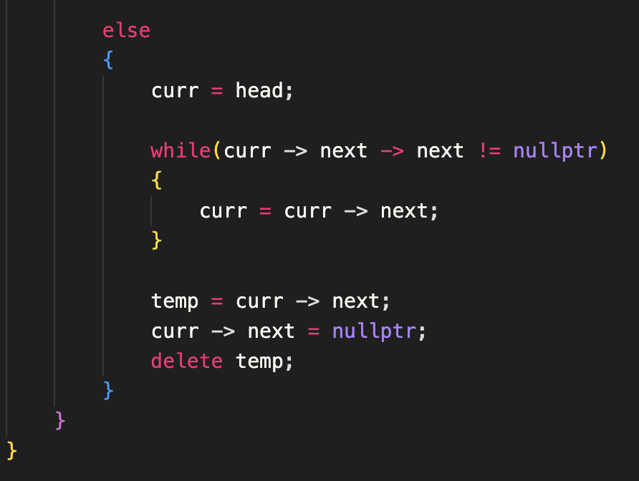
Solution

Slide 15
Deletion in Middle
Check if NOT isEmpty()
Traverse to the node BEFORE the node you want to delete (will be “curr”)
Set the node you want to delete (curr -> next in this case) to temp
You want curr to now point to the node AFTER the node you want deleted
Say you have linked list:
A -> B -> C
You want A to now point to C

Slide 16
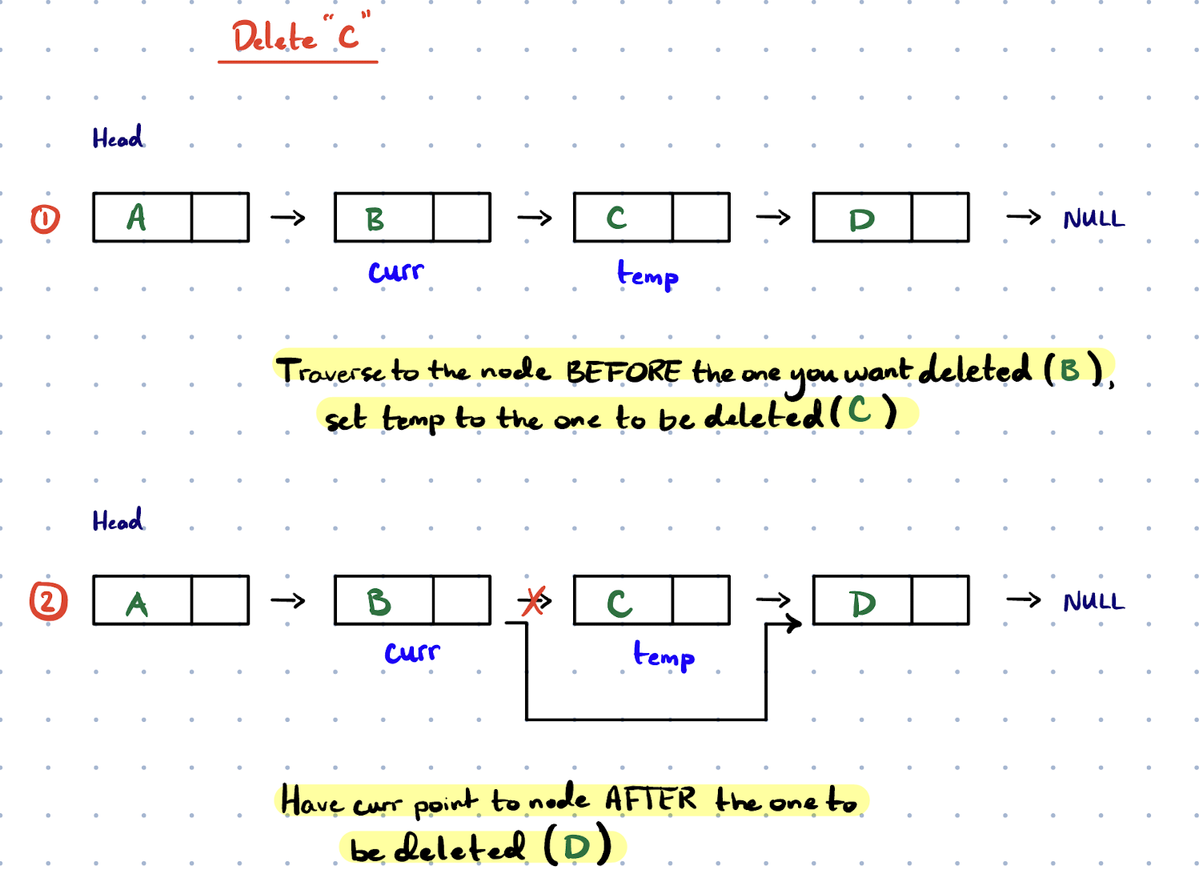
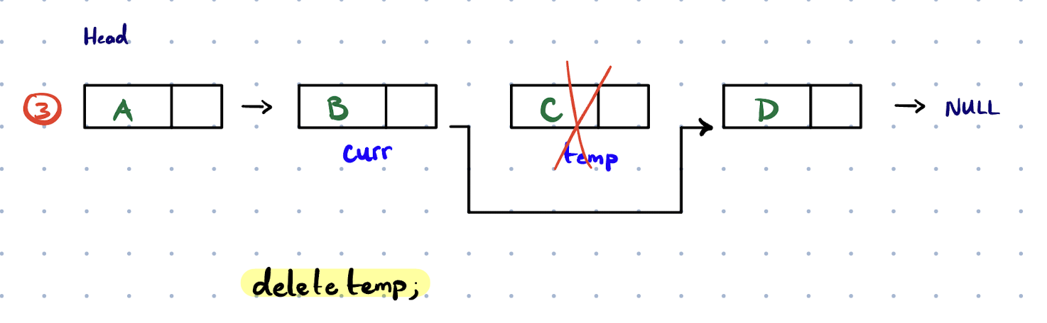
Illustration

Slide 17
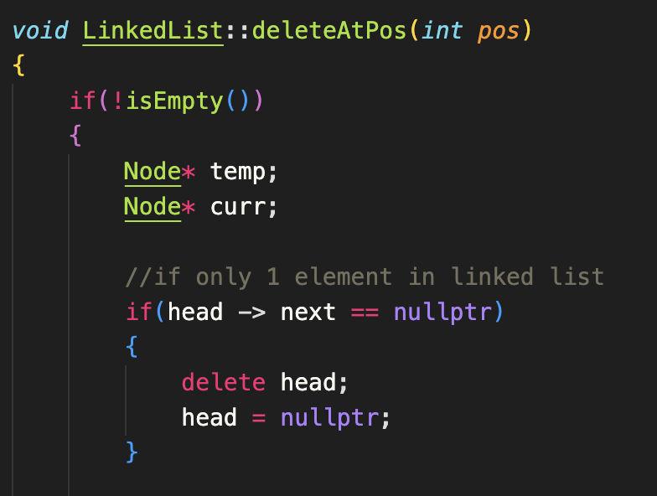
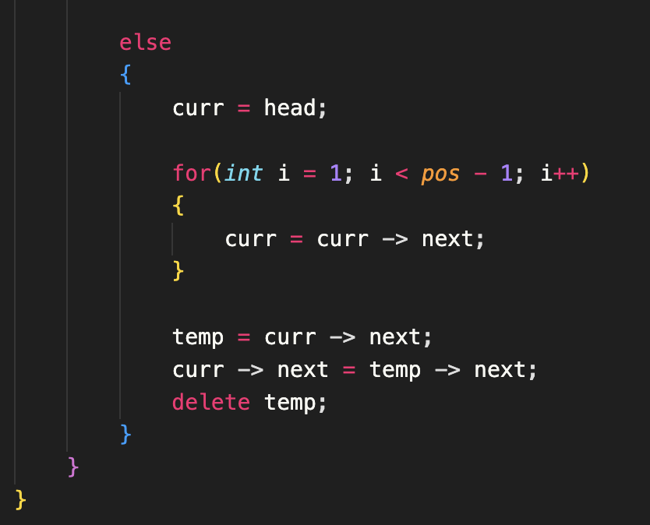
Solution

Slide 18
Other Linked List Functions

Slide 19
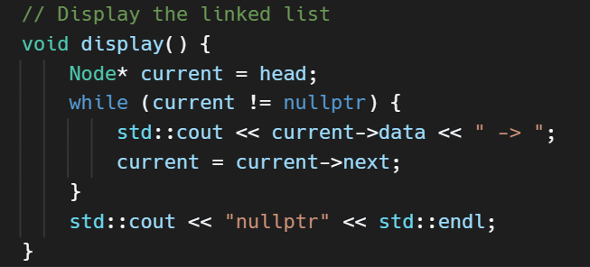
Printing the Linked List (5 mins)
Think about the iterative vs recursion
Given
void display(node * cur)

Slide 20
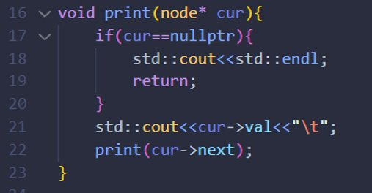
Recursive

Slide 21
Reversibly Print A Linked List (5 mins)
Given a linked list, recursively print out the Linked List backwards

Slide 22
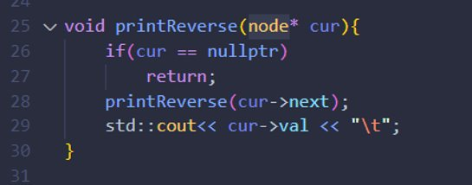
Understanding the memory stack
In this case we call the recursion first so that it prints out in reverse order since the cout line never runs until the recursive call is finished

Slide 23
Reverse a Linked List​
Given a head of a linked list, reverse the linked list and return the new head value
Try to draw out linkedlist

